Slide 1
Collaborative Professionalism

Slide 2
Discuss and understand the ten tenets of Collaborative Professionalism
Compare and apply this to our current work
Think more deeply about how to lead our shared work

Slide 3
Read the following quote
True or false?
An Why?

Slide 4
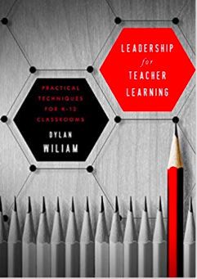
“Changing what teachers do in their classrooms involves changing highly automated routines,…
Changing practice is essentially a process of habit changing”

Slide 5
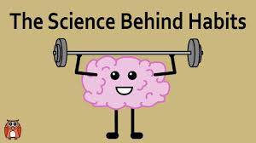
If it is true,
How do we change habits?

Slide 6
Collaborative professionalism: When teaching together means learning for all Hargreaves, & O’Conner (2018) Corwin

Slide 7
The problem with PLCs

Slide 8
In the context of compliance driven high stakes accountability…PLCs were overly directed from the top in ways that…
Undermined the authority and autonomy of teachers
Also, schools didn’t allow sufficient time to develop practices of inquiry that were robust and critical
Hargreaves & O’Conner (2018)

Slide 9
Collaborative professionalism is about how teachers and other educators transform teaching and learning together
It is evidence-informed,
Deep dialogue, with candid but constructive feedback
Continuous collaborative inquiry
Hargreaves & O’Conner (2018)

Slide 10
Tenets of Collaborative Professionalism
Collective autonomy
2. Collective Efficacy
3. Collaborative Inquiry
4. Collective responsibility
5. Collective Initiative
6. Mutual Dialogue
7. Joint Work
8. Common meaning and Purpose
9. Collaborating with students
10. Big-Picture Thinking for ALL

Slide 11
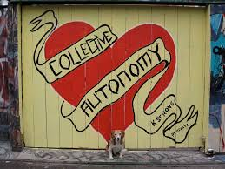
10 Tenets - 1. Collective autonomy
What is it?
Why is it important?
Talk together and report out
Hargreaves & O’Conner (2018)

Slide 12
10 Tenets - 1. Collective autonomy
It is NOT individual autonomy.
It is not the “egg crate!”
Teachers work is open to each other, and for feedback, inspiration, and assistance
Educators have more independence from top-down authority, but less independence from each other.
Professional Judgement is informed by a range of evidence
Hargreaves & O’Conner (2018)

Slide 13
10 Tenets- 2. Collective Efficacy
What is it?
Why is it important?
Talk together and report out
Hargreaves & O’Conner (2018)

Slide 14
10 Tenets- 2. Collective Efficacy
The belief that, together, we can make a difference to the students we teach, no matter what
We believe, that together, we can do better and have a greater impact in students
We are not perfect, but together we can improve
Hargreaves & O’Conner (2018)

Slide 15
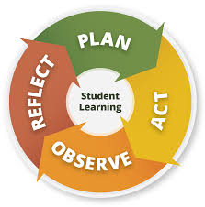
10 Tenets- 3. Collaborative Inquiry
What is it?
Why is it important?
Talk together and report out
Hargreaves & O’Conner (2018)

Slide 16
10 Tenets- 3. Collaborative Inquiry
Teachers routinely explore problems, issues, or differences of practice together in order to improve, or transform what they are doing.
It is embedded in the everyday work of teacher
Teachers use a range of evidence to underpin the inquiry and its findings
Then together they collaboratively make and implement plans based on what has been learned
Hargreaves & O’Conner (2018)

Slide 17
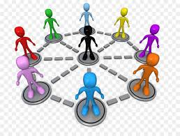
10 Tenets- 4. Collective responsibility
What is it?
Why is it important?
Talk together and report out
Hargreaves & O’Conner (2018)

Slide 18
10 Tenets- 4. Collective responsibility
We have a mutual obligation to help each other, and ALL of our students
We have an obligation to help each other become better
Accountability is the tiny remainder that is left once we subtract out responsibility
Hargreaves & O’Conner (2018)

Slide 19
10 Tenets- 5. Collective Initiative
What is it?
Why is it important?
Talk together and report out
Hargreaves & O’Conner (2018)

Slide 20
10 Tenets- 5. Collective Initiative
We have fewer initiatives, but more initiative.
Teacher step forward to help each other learn.
Teacher and student don’t wait to be asked
Educators are inspired and empowered to innovate in ways that engage students, and
Reignite their own passion for teaching
Hargreaves & O’Conner (2018)

Slide 21
10 Tenets- 6. Mutual Dialogue
What is it?
Why is it important?
Talk together and report out
Hargreaves & O’Conner (2018)

Slide 22
10 Tenets- 6. Mutual Dialogue
Talk is the work, but it is facilitated
We value differences of opinion about ideas
Difficult conversations are had, and feedback is honest, but protocols protect people and insist on clarification and listening before any disagreement.
Discussion develop a back and forth quality of genuine dialogue
Hargreaves & O’Conner (2018)

Slide 23
10 Tenets- 7. Joint Work
What is it?
Why is it important?
Talk together and report out
Hargreaves & O’Conner (2018)

Slide 24
10 Tenets- 7. Joint Work
Involves thoughtful explicit examination of practices and their outcomes
It involves dialogue and actions, artifacts, and products,
It is thinking and talking to improve professional practice
Hargreaves & O’Conner (2018)

Slide 25
10 Tenets- 8. Common meaning and Purpose
What is it?
Why is it important?
Talk together and report out
Hargreaves & O’Conner (2018)

Slide 26
10 Tenets- 8. Common meaning and Purpose
We have a common purpose that is greater than test scores or even academic achievement on it’s own
(i.e. creativity, critical thinking, character, equity, democracy)
It addresses and engages with educational goals that enable students to grow and flourish as whole people.
Hargreaves & O’Conner (2018)

Slide 27
10 Tenets- 9. Collaborating with students
What is it?
Why is it important?
Talk together and report out
Hargreaves & O’Conner (2018)

Slide 28
10 Tenets- 9. Collaborating with students
In it’s deepest form collaborative professionalism, students are actively engaged with their teachers in construction change together
Student voice is the extreme end of of student engagement
i.e. Cooperative learning and self regulated learning
Hargreaves & O’Conner (2018)

Slide 29
10 Tenets- 10. Big-Picture Thinking for ALL
What is it?
Why is it important?
Talk together and report out
Hargreaves & O’Conner (2018)

Slide 30
10 Tenets- 10. Big-Picture Thinking for ALL
Everyone understands the big picture. They see it, live it, and create it together
We take responsibility for our Learning Organization
We know why we are here
Hargreaves & O’Conner (2018)

Slide 31
Collaborative Professionalism should:
Promote regular feedback related to improvement
Involve everyone- NO exceptions
Everyone is responsible
Include collective responsibility for everyone's impact on ALL students.

Slide 32
Brian A McNulty Ph. D.
Brian.mcnulty@creativeleadership.net
303-819-1625

