Slide 1
Five Things Principals
Should Know and Do
Brian A. McNulty Ph.D.
Part One

Slide 2
Outcomes
Participants will understand the importance of…

Slide 3
Outcomes
Participants will understand the importance of…
Focus

Slide 4
Outcomes
Participants will understand the importance of…
Focus
Leading teacher learning

Slide 5
Outcomes
Participants will understand the importance of…
Focus
Leading teacher learning
Collective leadership and teams

Slide 6
Outcomes
Participants will understand the importance of…
Focus
Leading teacher learning
Collective leadership and teams
Sharing our learning

Slide 7
Outcomes
Participants will understand the importance of…
Focus
Leading teacher learning
Collective leadership and teams
Sharing our learning
Classroom Observations and Coaching

Slide 8
If you don’t know what is working…

Slide 9
If you don’t know what is working…
…how do you expect to make progress?

Slide 10
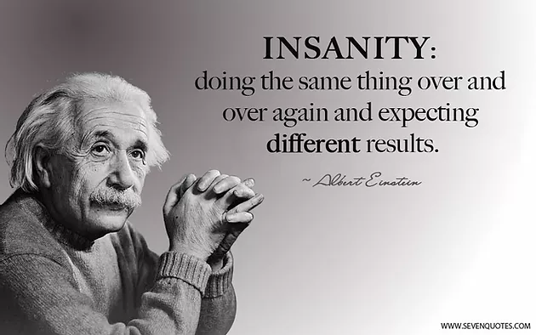
A Basic Understanding
Schools don’t get better by doing the same things!

Slide 11
Schools don’t get better until…

Slide 12
Schools don’t get better until…
They use (teaching and leadership) practices that work better.

Slide 13
Schools don’t get better until…
They use (teaching and leadership) practices that work better.
They figure out what works better here
For our kids,
In our school?
Why?

Slide 14
Schools don’t get better until…
They use (teaching and leadership) practices that work better.
They figure out what works better here
For our kids,
In our school?
Why?
They actually see and document what works better here.

Slide 15
Focusing on High-Impact Teaching and Learning
0.84

Slide 16
Know Thy Impact!
Hattie, 2009, 2011, 2014

Slide 17
What is the first thing that you need to do to help your schools?
Talk together and then
see if you can reach agreement

Slide 18
The primary reason for our lack of success is…
Payne, C., (2011)

Slide 19
The primary reason for our lack of success is…
…our addiction to excess!
Payne, C., (2011)

Slide 20
Focus Is the
First Obligation of Leaders
Reeves, 2011

Slide 21
Focus
Marzano, Waters, McNulty (2005)
Sanborn (2006)
Robinson (2011)
Reeves (2011)
Schmoker (2011, 2018)
McNulty & Besser (2014)
McChesney, et al. (2012)
Keller & Papason (2013)
Goleman (2013)
Smith & White (2014)
Hansen (2018)
Robinson, V. (2018)
Payne (2011)
Hansen (2018)

Slide 22
Five-Year Study
Five Thousand Leaders
The number one reason for
success was focus.

Slide 23
Viviane Robinson
Student performance was increased when schools reduced the number of initiatives and helped people to focus.

Slide 24
Leadership and Learning Center
Two Thousand Schools
The single variable that had the highest relationship to increased student performance was focus.

Slide 25
Think about Your Work
How many priorities are you and your school currently working on?
See if you can come up with a comprehensive list with your BLT.
What can you and your BLT do to reduce the number of initiatives and FOCUS?
What is the highest need you have?
See if you can reach consensus with your BLT.
Next, talk with your BLT and see if you can agree on a single focus.

Slide 26
The DNA of the school needs to be learning…

Slide 27
The DNA of the school needs to be learning…
…not only for students, but for all staff, especially your teams!

Slide 28
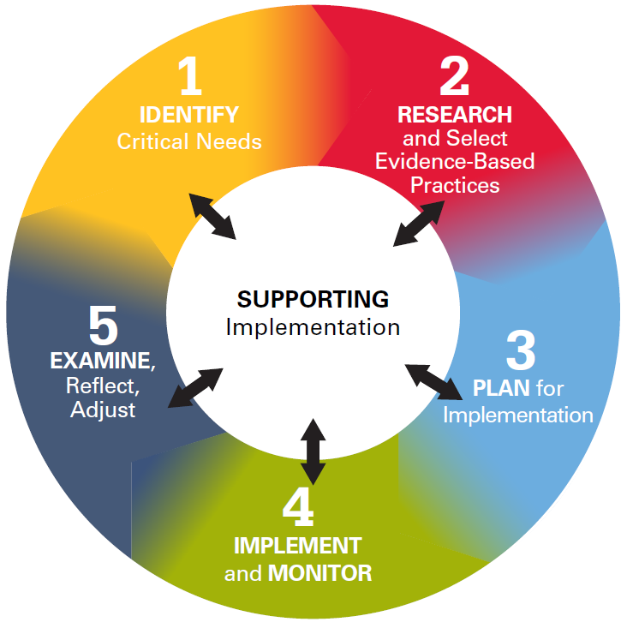
Collaborative Inquiry
Collaborative Learning

Slide 29
The primary issue is to change the culture of the school and the district so that learning is the work.
Fullan (2014)

Slide 30
Our goal (Big Question) is to find out..
What works best for our kids,
Here in our school
WHY?
How do we learn this?
How do we share this knowledge across the school?

Slide 31
We have a bias for action…
…instead of a bias for learning
Cashman 2012

Slide 32
Research consistently show that supporting adult learning is directly and positively linked to enhancing children’s achievement.
Drago-Severson, 2009

Slide 33
This Is a Learning Agenda
As individuals
But more importantly as teams
The measures of effectiveness are:
What have we done?
How well did it work?
How do we know?
What have we learned?
Strategic Learning Agenda

Slide 34
Second BIG Idea Regarding Principal Leadership

Slide 35
Robinson – 5 Critical Things Principals Do

Slide 36
Robinson – 5 Critical Things Principals Do
Establish goals and expectations
Robinson, 2011

Slide 37
Robinson – 5 Critical Things Principals Do
Establish goals and expectations
Resourcing Strategically
Robinson, 2011

Slide 38
Robinson – 5 Critical Things Principals Do
Establish goals and expectations
Resourcing Strategically
Ensuring quality teaching
Robinson, 2011

Slide 39
Robinson – 5 Critical Things Principals Do
Establish goals and expectations
Resourcing Strategically
Ensuring quality teaching
Leading teacher learning and development
Robinson, 2011

Slide 40
Robinson – 5 Critical Things Principals Do
Establish goals and expectations
Resourcing Strategically
Ensuring quality teaching
Leading teacher learning and development
Ensuring an orderly and supportive environment
Robinson, 2011

Slide 41
_{Viviane Robinsons Findings}

Slide 42
The single Focus of the school should be…

Slide 43
The single Focus of the school should be…
…Collaborative Learning through
Collaborative Inquiry.

Slide 44
Principals should be actively involved as the “lead learner” of their school.
Start with the Principal
Robinson 2007, 2008, 2011

Slide 45
The Truth The best leaders are the best learners.
Learning is the master skill.
Kouzes & Posner (2010)

Slide 46
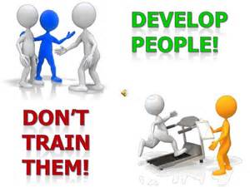
Principals must be willing to both develop and learn from their BLT and TBTs

Slide 47
Direct participation in the learning enables principals to more fully understand the challenges, opportunities, and conditions teachers need to be successful.
Robinson 2007, 2008, 2011

Slide 48
As principals become stronger instructional leaders…
Robinson, 2011

Slide 49
As principals become stronger instructional leaders…
…teachers see them as more knowledgeable
and as a source of instructional advice.
Robinson, 2011

Slide 50
What does it mean to be a Learner versus a Knower?
Talk over this idea with your BLT and
come up with descriptors for both.

Slide 51
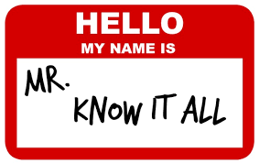
Knowledge is a good thing…

Slide 52
Knowledge is a good thing…
…unless we think we know
all that we need to know!

Slide 53
Be a Learner, Not a Knower

Slide 54
Be a Learner, Not a Knower
“Knowers often believe that they know all that they need to know to address the current problem.”
Hinken (2005)

Slide 55
Be a Learner, Not a Knower
“Knowers often believe that they know all that they need to know to address the current problem.”
While knowledge is a good thing (in routine situations), being a “knower” doesn’t work well in novel situations, or when learning new behaviors. (Technical vs Adaptive Learning --Heifitz)
Hinken (2005)

Slide 56
Be a Learner, Not a Knower
“Knowers often believe that they know all that they need to know to address the current problem.”
While knowledge is a good thing (in routine situations), being a “knower” doesn’t work well in novel situations, or when learning new behaviors. (Technical vs Adaptive Learning --Heifitz)
In novel situations people need to be learners and engage in inquiry, dialogue, and discovery, in team learning.
Hinken (2005)

Slide 57
Also remember to be vulnerable!
A few simple, uncommon, powerful phrases….make our teams feel more psychologically safe:
- I don’t know.
- I need help.
- I made a mistake.
- I’m sorry.
Edmondson 2019

Slide 58
Third BIG Idea Regarding Principal Leadership
Collective Leadership and Teacher Teams

Slide 59
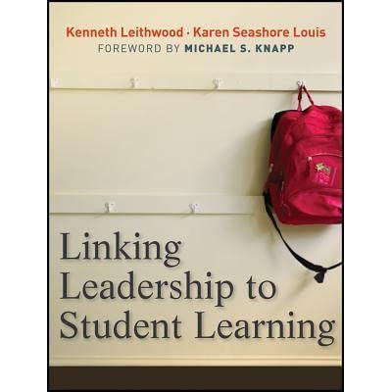
Largest Leadership Study to Date
Nine states
43 school districts
180 schools
Data from a total of 8,391 teachers and 471 school administrators
Leithwood, & Seashore Louis (2012)

Slide 60
Two Overall Findings
Collective leadership (collective capacity) has a stronger influence on student learning than any individual source of leadership.
Higher-performing schools award greater influence to teacher teams
Seashore Louis et. al, 2010

Slide 61
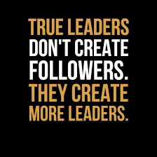
You need more leaders to change the whole school.

Slide 62
You need more leaders to change the whole school.
Principals have more limited credibility when it comes to teaching and learning.

Slide 63
You need more leaders to change the whole school.
Principals have more limited credibility when it comes to teaching and learning.
Teachers trust each other more than principals.

Slide 64
You need more leaders to change the whole school.
Principals have more limited credibility when it comes to teaching and learning.
Teachers trust each other more than principals.
Teachers need to lead this change work.

Slide 65
Reeves (2008)

Slide 66
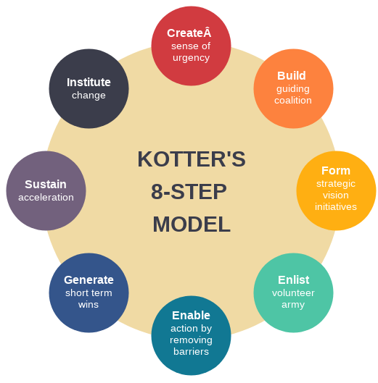
You won’t make it alone!

Slide 67
You won’t make it alone!
Change requires a range of knowledge and skills

Slide 68
You won’t make it alone!
Change requires a range of knowledge and skills
There is too much Information to process alone

Slide 69
You won’t make it alone!
Change requires a range of knowledge and skills
There is too much Information to process alone
You need different perspectives and solutions

Slide 70
You won’t make it alone!
Change requires a range of knowledge and skills
There is too much Information to process alone
You need different perspectives and solutions
You need more credibility and skills

Slide 71
Developing More Leaders

Slide 72
Developing More Leaders
Principals need to first select/develop more leaders on the BLT.

Slide 73
Developing More Leaders
Principals need to first select/develop more leaders on the BLT.
BLT members need to identify and develop more leaders from the TBTs.

Slide 74
The most effective way to develop more leaders is through..

Slide 75
The most effective way to develop more leaders is through..
Building Leadership Team

Slide 76
Opinion Leaders
Rogers, (2003)
Kotter, (1996,2012)

Slide 77
Opinion Leaders
Expertise, knowledge and skills
Rogers, (2003)
Kotter, (1996,2012)

Slide 78
Opinion Leaders
Expertise, knowledge and skills
High credibility: They are who people go to for advice, opinions, or guidance.
Rogers, (2003)
Kotter, (1996,2012)

Slide 79
Opinion Leaders
Expertise, knowledge and skills
High credibility: They are who people go to for advice, opinions, or guidance.
Thought leaders, influential and respected members of the community
Rogers, (2003)
Kotter, (1996,2012)

Slide 80
Opinion Leaders
Expertise, knowledge and skills
High credibility: They are who people go to for advice, opinions, or guidance.
Thought leaders, influential and respected members of the community
Both leaders and team players
Rogers, (2003)
Kotter, (1996,2012)

Slide 81
Opinion Leaders
Expertise, knowledge and skills
High credibility: They are who people go to for advice, opinions, or guidance.
Thought leaders, influential and respected members of the community
Both leaders and team players
Avoid "snakes and egos“ (Kotter)
Rogers, (2003)
Kotter, (1996,2012)

Slide 82
Opinion Leaders
Expertise, knowledge and skills
High credibility: They are who people go to for advice, opinions, or guidance.
Thought leaders, influential and respected members of the community
Both leaders and team players
Avoid "snakes and egos“ (Kotter)
Develop trust and common goals
Rogers, (2003)
Kotter, (1996,2012)

Slide 83
BLT Membership
You need to have the right people on your BLTs. Choose teachers (opinion leaders) who:

Slide 84
BLT Membership
You need to have the right people on your BLTs. Choose teachers (opinion leaders) who:
Are respected for their content and pedagogical knowledge

Slide 85
BLT Membership
You need to have the right people on your BLTs. Choose teachers (opinion leaders) who:
Are respected for their content and pedagogical knowledge
Who are socially well connected

Slide 86
BLT Membership
You need to have the right people on your BLTs. Choose teachers (opinion leaders) who:
Are respected for their content and pedagogical knowledge
Who are socially well connected
Who can maintain confidentiality

Slide 87
BLT Membership
You need to have the right people on your BLTs. Choose teachers (opinion leaders) who:
Are respected for their content and pedagogical knowledge
Who are socially well connected
Who can maintain confidentiality
Who are curious

Slide 88
BLT Membership
You need to have the right people on your BLTs. Choose teachers (opinion leaders) who:
Are respected for their content and pedagogical knowledge
Who are socially well connected
Who can maintain confidentiality
Who are curious
Who are willing to lead

Slide 89
BLT Membership
You need to have the right people on your BLTs. Choose teachers (opinion leaders) who:
Are respected for their content and pedagogical knowledge
Who are socially well connected
Who can maintain confidentiality
Who are curious
Who are willing to lead
Don’t be afraid to change the membership!

Slide 90
Build a strong guiding team (coalition) with the right composition and trust.
“Weak teams always fail.”
Kotter, (1996,2012)

Slide 91
End of Part One
Five Things Principals Should Know and Do
Brian A. McNulty Ph.D.

